Slide 1
UNIT –III Big Data Analytics

Slide 2
Analytics
The analytical findings can lead to
more effective marketing,
better customer service and satisfaction,
newer products and services,
improved operational efficiency,
reduced expenditure,
competitive advantages over rival organizations,
boosted business gains, etc.

Slide 3
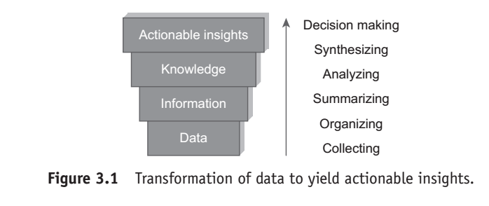
WHERE DO WE BEGIN?

Slide 4
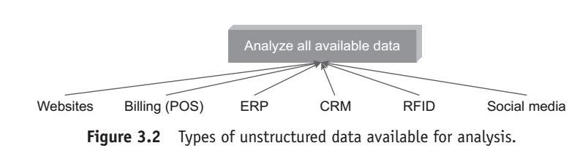
Types of Unstructured Data Available for Analysis

Slide 5
Big data analytics
Big data analytics is the process of examining big data to
uncover patterns,
unearth trends,
find unknown correlations
and other useful information to make faster and better decisions.
Analytics begin with analyzing all available data.

Slide 6
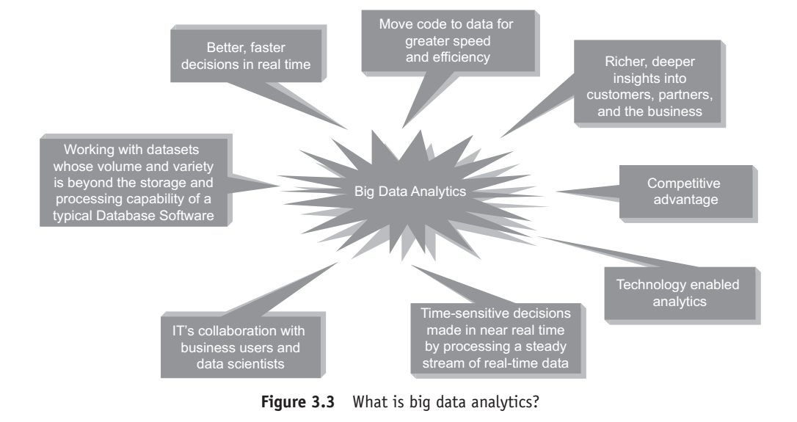
WHAT IS BIG DATA ANALYTICS?

Slide 7
Big Data Analytics is
1. Technology-enabled analytics:
Quite a few data analytics and visualization tools are available in the market today from leading vendors such as
IBM, Tableau,
SAS, R Analytics,
Statistica,
World Programming Systems (WPS),
etc. to help process and analyze your big data.

Slide 8
2. About gaining
a meaningful,
deeper,
and richer insight into your business
to steer it in
the right direction,
understanding the customer’s demographics
to cross-sell and up-sell to them,
better leveraging the services of your vendors and suppliers, etc.

Slide 9
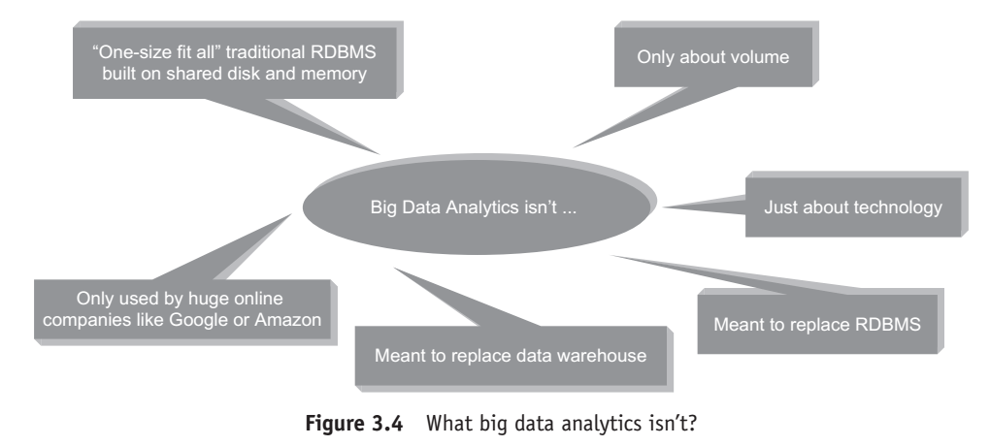
Big Data Analytics isn’t?

Slide 10
CLASSIFICATION OF ANALYTICS
There are basically two schools of thought:
1. Those that classify analytics into basic, operational ized, advanced, and monetized.
2. Those that classify analytics into analytics
1.0, analytics
2.0 analytics
and analytics 3.0.

Slide 11
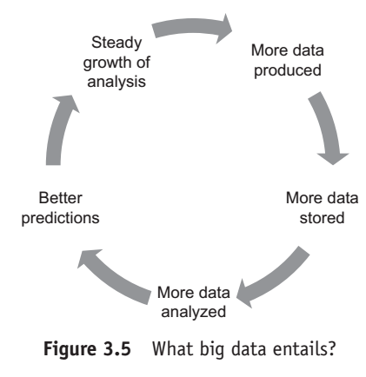

Slide 12
First School of Thought
1.Basic analytics:
--This primarily is slicing and dicing of data to help with basic business insights.
--This is about reporting on historical data, basic visualization, etc.
2. Operationalized analytics:
It is operationalized analytics if it gets woven into the enterprise’s business processes.

Slide 13
3. Advanced analytics:
This largely is about forecasting for the future by way of predictive and prescriptive modeling.
4. Monetized analytics:
This is analytics in use to derive direct business revenue.

Slide 14
3.5.2 Second School of Thought
analytics 1.0,
analytics 2.0,
analytics 3.0.

Slide 15
analytics 1.0,
Era: mid 1950s to 2009
Descriptive statistics (report on events, occurrences, etc. of the past)
Key questions asked:
What happened?
Why did it happen?

Slide 16
Data from
Legacy systems,
ERP,
CRM, and
3rd party applications.
Small and structured data sources.
Data stored in enterprise data warehouses or data marts.

Slide 17
Data was internally sourced.
Relational databases

Slide 18
analytics 2.0
2005 to 2012
Descriptive statistics + predictive statistics
(use data from the past to make predictions for the future)

Slide 19
Key questions asked:
What will happen?
Why will it happen?
Big data

Slide 20
Big data is being taken up seriously.
Data is mainly unstructured, arriving at a much higher pace.
This fast flow of data entailed that the influx of big
volume data had to be stored and processed rapidly,
often on massive parallel servers running Hadoop.

Slide 21
Data was often externally sourced.
Database appliances, Hadoop clusters, SQL to Hadoop environments, etc.

Slide 22
analytics 3.0.
2012 to present
Descriptive + predictive + prescriptive statistics
(use data from the past to make prophecies for the future and at the same time make recommendations to leverage the situation to one’s advantage)

Slide 23
Key questions asked:
What will happen?
When will it happen?
Why will it happen?
What should be the action taken to take advantage of what will happen?

Slide 24
A blend of
big data and
data from legacy systems, ERP, CRM, and 3rd party applications.
Data is both being internally and externally sourced.

Slide 25
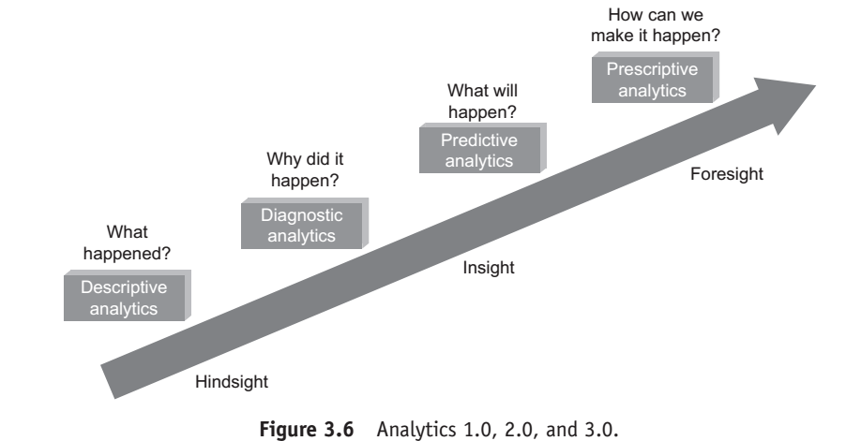
Analytics 1.0,2.0 and 3.0

Slide 26
DATA SCIENCE
Data science is the science of extracting knowledge from data.
In other words, it is a science of drawing out hidden patterns amongst data using statistical and mathematical techniques.

Slide 27
Business Acumen Skills
A data scientist should have the prowess to counter the pressures of business.
A firm understanding of business domain further helps.

Slide 28
The following is a list of traits that needs to be honed to play the role of data scientist.
1. Understanding of domain.
2. Business strategy.
3. Problem solving.
4. Communication.
5. Presentation.
6. Inquisitiveness.

Slide 29
Technology Expertise
It goes without saying that technology expertise will come in handy if one is to play the role of a data scientist.

Slide 30
1.Good database knowledge such as RDBMS.
2. Good NoSQL database knowledge such as MongoDB, Cassandra, HBase, etc.
3. Programming languages such as Java, Python, C++, etc.

Slide 31
4. Open-source tools such as Hadoop.
5. Data warehousing.
6. Data mining.
7. Visualization such as Tableau, Flare, Google visualization APIs, etc.

Slide 32
Mathematics Expertise
Since the core job of the data scientist will require him to comprehend data, interpret it, make sense of it, and analyze it, he/she will have to dabble in learning algorithms.

Slide 33
The following are the key skills that a data scientist will have to have in his arsenal.
1. Mathematics.
2. Statistics.
3. Artificial Intelligence (AI).

Slide 34
4. Algorithms.
5. Machine learning.
6. Pattern recognition.
7. Natural Language Processing.

Slide 35
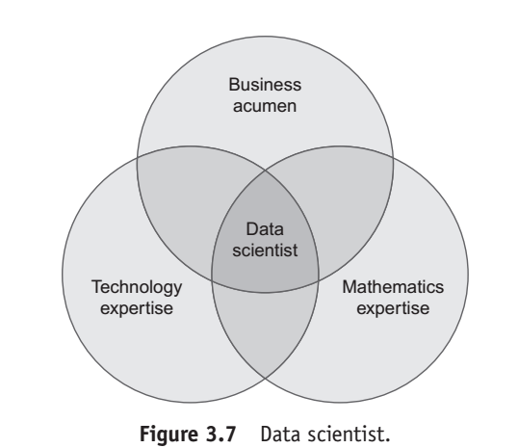
Data Scientist

Slide 36
Data science process is
1. Collecting raw data from multiple disparate data sources.
2. Processing the data.
3. Integrating the data and preparing clean datasets.
4. Engaging in explorative data analysis using model and algorithms.
.

Slide 37
5. Preparing presentations using data visualizations (commonly called Infographics, or BizAnalytics, or VizAnalytics, etc.)
6. Communicating the findings to all stakeholders.
7. Making faster and better decisions.

Slide 38
DATA SCIENTIST…YOUR NEW BEST FRIEND!!!
In today’s data age,
a data scientist is the best friend that you can gift yourself.

Slide 39
Responsibilities of a Data Scientist
1. Data Management:
A data scientist employs several approaches to develop the relevant datasets for analysis.
Raw data is just “RAW,” unsuitable for analysis.

Slide 40
The data scientist works on it to prepare it to reflect the relationships and contexts.
This data then becomes useful for processing and further analysis.

Slide 41
2. Analytical Techniques:
Depending on the business questions
which we are trying to find answers to and the type of data available at hand, the data scientist employs a blend of analytical techniques
to develop models and algorithms to understand the data, interpret relationships, spot trends, and unveil patterns.

Slide 42
3. Business Analysts:
A data scientist is a business analyst who distinguishes cool facts from insights and is able to apply his business acumen and domain knowledge to see the results in the business context.
He is a good presenter and communicator who is able to communicate the results of his findings in a language that is understood by the different business stakeholders.

Slide 43
TERMINOLOGIES USED IN BIG DATA ENVIRONMENTS
In-Memory Analytics
In-Database Processing
Symmetric Multiprocessor System (SMP)

Slide 44
In-Memory Analytics
Data access from non-volatile storage such as hard disk is a slow process.
The more the data is required to be fetched from hard disk or secondary storage, the slower the process gets.

Slide 45
One way to combat this challenge is to pre-process and store data (cubes, aggregate tables, query sets, etc.)
so that the CPU has to fetch a small subset of records. But this requires thinking in advance as to what data will be required for analysis.

Slide 46
If there is a need for different or more data, it is back to the initial process of pre-computing and storing data or fetching it from secondary storage.
This problem has been addressed using in-memory analytics.

Slide 47
Here all the relevant data is stored in Random Access Memory (RAM) or primary storage thus eliminating the need to access the data from hard disk.
The advantage is faster access, rapid deployment, better insights, and minimal IT involvement.

Slide 48
In-Database Processing
In-database processing is also called as in-database analytics. It works by fusing data warehouses with analytical systems.

Slide 49
Typically the data from various enterprise On Line Transaction Processing (OLTP) systems after cleaning up (de-duplication, scrubbing, etc.) through the process of ETL is stored in the Enterprise Data Warehouse (EDW) or data marts.

Slide 50
The huge datasets are then exported to analytical programs for complex and extensive computations.
With in-database processing, the database program itself can run the computations eliminating the need for export and thereby saving on time. Leading database vendors are offering this feature to large businesses.

Slide 51
Symmetric Multiprocessor System (SMP)
In SMP, there is a single common main memory that is shared by two or more identical processors. The processors have full access to all I/O devices and are controlled by a single operating system instance.

Slide 52
SMP are tightly coupled multiprocessor systems. Each processor has its own high-speed memory, called cache memory and are connected using a system bus.

Slide 53
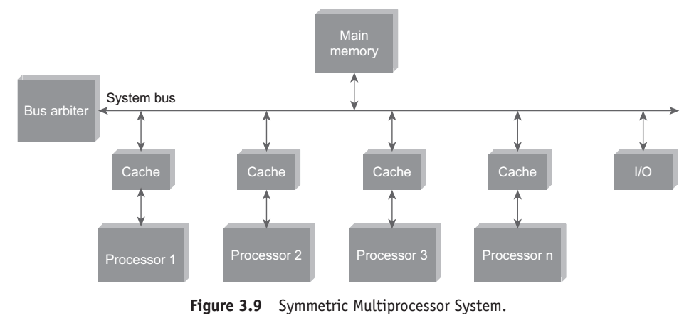

Slide 54
Massively Parallel Processing
Massive Parallel Processing (MPP) refers to the coordinated processing of programs by a number of processors working parallel. The processors, each have their own operating systems and dedicated memory.

Slide 55
They work on different parts of the same program. The MPP processors communicate using some sort of messaging interface. The MPP systems are more difficult to program as the application must be divided in such a way that all the executing segments can communicate with each other.

Slide 56
MPP is different from Symmetrically Multiprocessing (SMP) in that SMP works with the processors sharing the same operating system and same memory. SMP is also referred to as tightly-coupled multiprocessing.

Slide 57
Difference Between Parallel and Distributed Systems
The next two terms that we discuss are parallel and distributed systems. As is evident from Figure 3.10, a parallel database system is a tightly coupled system. The processors co-operate for query processing. The user is unaware of the parallelism since he/she has no access to a specific

Slide 58
processor of the system. Either the processors have access to a common memory (Refer Fig 3.11) or make use of message passing for communication. Distributed database systems are known to be loosely coupled and are composed by individual machines. Refer Figure 3.12.

Slide 59
Each of the machines can run their individual application and serve their own respective user. The data is usually distributed across several machines, thereby necessitating quite a number of machines to be accessed to answer a user query. Refer Figure 3.13.

Slide 60
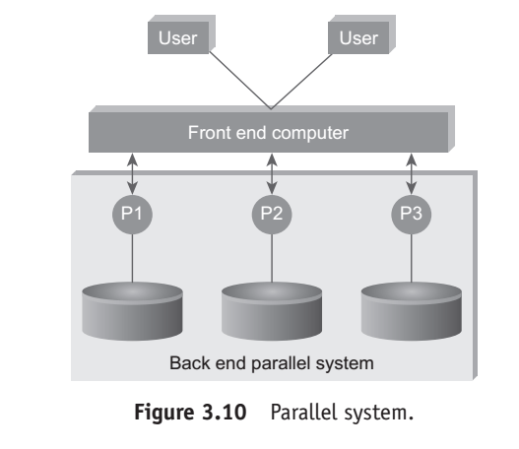

Slide 61
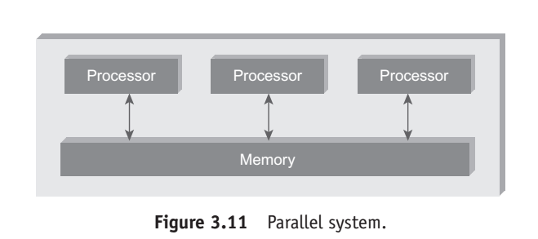

Slide 62
Shared Nothing Architecture
Let us look at the three most common types of architecture for multiprocessor high transaction rate systems.
They are:
1. Shared Memory (SM).
2. Shared Disk (SD).
3. Shared Nothing (SN).

Slide 63
In shared memory architecture, a common central memory is shared by multiple processors.
In shared disk architecture, multiple processors share a common collection of disks while having their own private memory.

Slide 64
In shared nothing architecture, neither memory nor disk is shared among multiple processors.

Slide 65
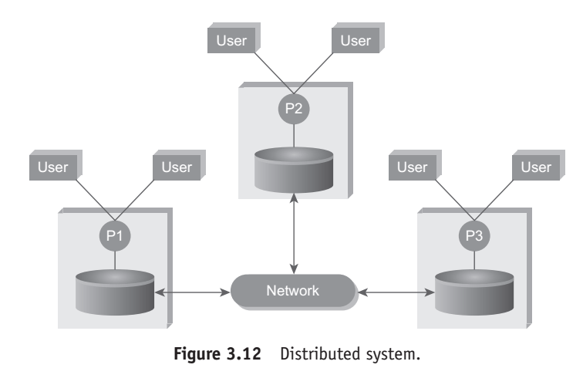

Slide 66
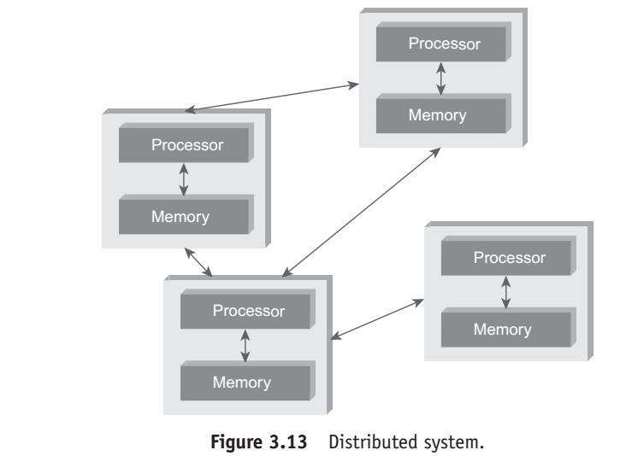

Slide 67
Advantages of a “Shared Nothing Architecture”
1. Fault Isolation:
A “Shared Nothing Architecture” provides the benefit of isolating fault.
A fault in a single node is contained and confined to that node exclusively and exposed only through messages (or lack of it).

Slide 68
2. Scalability:
Assume that the disk is a shared resource. It implies that the controller and the disk bandwidth are also shared. Synchronization will have to be implemented to maintain a consistent shared state.

Slide 69
This would mean that different nodes will have to take turns to access the critical data.
This imposes a limit on how many nodes can be added to the distributed shared disk system, thus compromising on scalability.

Slide 70
2. Scalability:
Assume that the disk is a shared resource.
It implies that the controller and the disk bandwidth are also shared.
Synchronization will have to be implemented to maintain a consistent shared state.

Slide 71
This would mean that different nodes will have to take turns to access the critical data.
This imposes a limit on how many nodes can be added to the distributed shared disk system, thus compromising on scalability.

Slide 72
CAP Theorem Explained
The CAP theorem is also called the Brewer’s Theorem.
It states that in a distributed computing environment (a collection of interconnected nodes that share data), it is impossible to provide the following guarantees.
At best you can have two of the following three – one must be sacrificed.
1. Consistency 2. Availability 3. Partition tolerance

Slide 73
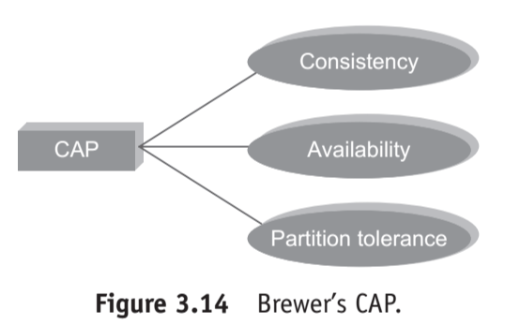

Slide 74
CAP Theorem
Let us spend some time understanding the earlier mentioned terms.
1. Consistency implies that every read fetches the last write.

Slide 75
2. Availability implies that reads and writes always succeed.
In other words, each non-failing node will return a response in a reasonable amount of time.

Slide 76
3. Partition tolerance implies that the system will continue to function when network partition occurs.

Slide 78
TEST ME
A. Fill Me
1. The __________technology helps query data that resides in a computer’s random access memory (RAM) rather than data stored on physical disks.
2. Eventual consistency is a consistency model used in distributed computing to achieve high_________.

Slide 79
3. A coordinated processing of a program by multiple processors, each working on different parts of the program and using its own operating system and memory is called___________.
4. A collection of independent computers that appear to its users as a single coherent system is__________.

Slide 80
Answers:
1. In-memory analytics
2. Availability
3. Massively parallel processing
4. Distributed systems

Slide 81
B. Answer Me
1. What are the various types of analytics?

Slide 82
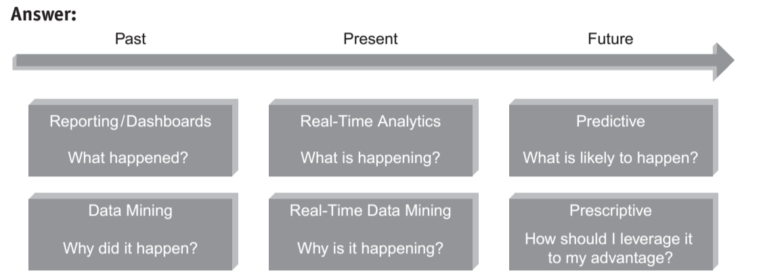

Slide 83
2. What are the key questions to be answered by all organizations stepping into analytics?

Slide 84
Answer: The key questions for any organization stepping into analytics are:
• Should you be storing all of your big data?
If “Yes”, where are you going to store it? If “No”, how will you know what to store and what to discard?
• How will you sieve through your massive data to filter out the relevant from the irrelevant?

Slide 85
• How long will you store this data?
• How will you accommodate the peaks (variability in terms of data influx) in your data?
• How will you analyze?

Slide 86
Will you analyze all the data that is stored or analyze a sample?
• What will you do with the insights generated from this analysis?

Slide 87
3. What can one expect from analytics 3.0?

Slide 88
• In-memory analytics.
• In-database processing.
• Leveraging analytics to improve operational, tactical, and strategic decision making.

Slide 89
• Coupling the in-memory analytics and in-database processing with agile analytical methods and machine learning techniques.
• Appropriate tools to effectively support decision-making at the front lines, such as mobile and selfserve analytical applications.

Slide 90
4. Which industries will be affected most by analytics 3.0?
Who will benefit the most?

Slide 91
Answer:
Almost all the firms in all the industries and not just online firms will be affected by analytics 3.0.
A lot of analytics have already been done in the Transport, Retail, and Banking sector. Telecom, entertainment, and health sectors have a bit of catching up to do.

Slide 92
5. What is predictive and prescriptive analytics?

Slide 93
Predictive analytics helps you answer the questions: “What will happen?” and “Why will it happen”?
Prescriptive analytics goes beyond “What will happen?” “Why will it happen?” and “When will it happen?” to answer “What should be the action taken to take advantage of what will happen”?

Slide 94
The Big Data Technology Landscape

Slide 95
The big data technology landscape can be majorly studied under two important technologies:
1. NoSQL
2. Hadoop

Slide 96
NoSQL (NOT ONLY SQL)
The term NoSQL was first coined by Carlo Strozzi in 1998
to name his lightweight, open-source, non-relational database
that did not expose the standard SQL interface.
The term was reintroduced by Eric Evans in early 2009.

Slide 97
Where is it Used?
NoSQL databases are widely used in big data and other real-time web applications.
NoSQL databases is used to stock log data which can then be pulled for analysis.
Likewise it is used to store social media data and all such data which cannot be stored and analyzed comfortably in RDBMS.

Slide 98
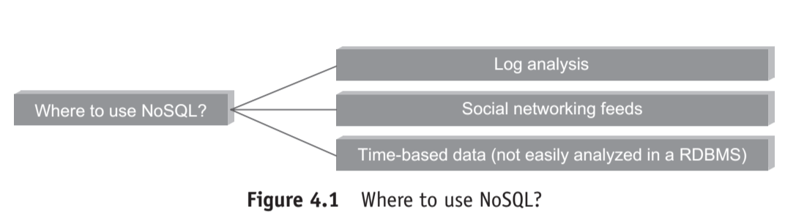

Slide 99
What is it?
NoSQL stands for Not Only SQL.
These are non-relational, open source, distributed databases.
They are hugely popular today owing to their ability to scale out or scale horizontally and the adeptness at dealing with a rich variety of data:
structured,
semi-structured and
unstructured data.

Slide 100
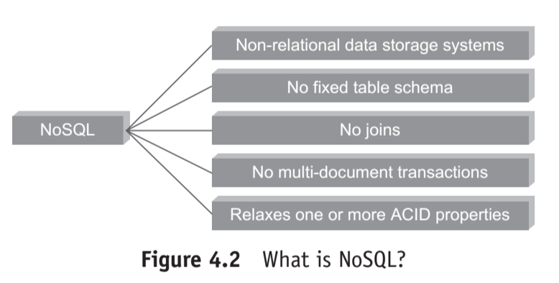

Slide 101
1. NoSQL databases are non-relational:
They do not adhere to relational data model..
In fact, they are either
key-value pairs or
document-oriented or
column-oriented or
graph-based databases.

Slide 102
2. Distributed:
They are distributed meaning the data is distributed across several nodes in a cluster constituted of low-cost commodity hardware.

Slide 103
3. No support for ACID properties (Atomicity, Consistency, Isolation, and Durability):
They do not offer support for ACID properties of transactions.
On the contrary, they have adherence to Brewer’s CAP (Consistency, Availability, and Partition tolerance) theorem and are often seen compromising on consistency in favor of availability and partition tolerance.

Slide 104
4. No fixed table schema:
NoSQL databases are becoming increasing popular owing to their support for flexibility to the schema.
They do not mandate for the data to strictly adhere to any schema structure at the time of storage.

Slide 105
Types of NoSQL Databases
NoSQL databases are non-relational.
They can be broadly classified into the following:
1. Key−value or the big hash table.
2. Schema-less.

Slide 106
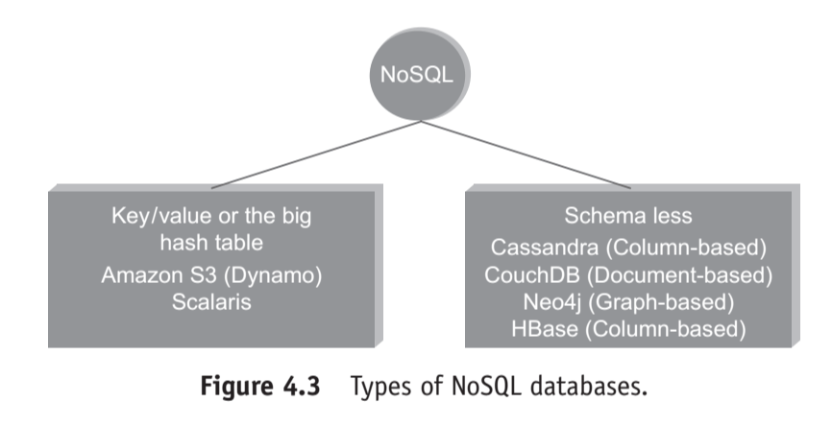

Slide 107
key−value and few other types of schema-less databases:
1. Key−value:
It maintains a big hash table of keys and values.
For example, Dynamo, Redis, Riak, etc. Sample Key−Value Pair in Key−Value Database

Slide 108
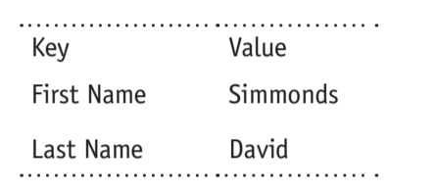

Slide 109
2. Document:
It maintains data in collections constituted of documents.
For example, MongoDB, Apache CouchDB, Couchbase, MarkLogic, etc.

Slide 110
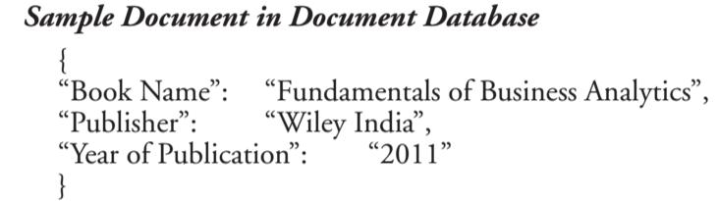

Slide 111
3. Column:
Each storage block has data from only one column.
For example: Cassandra, HBase, etc.

Slide 112
4. Graph:
They are also called network database.
A graph stores data in nodes.
For example, Neo4j, HyperGraphDB, etc.

Slide 113
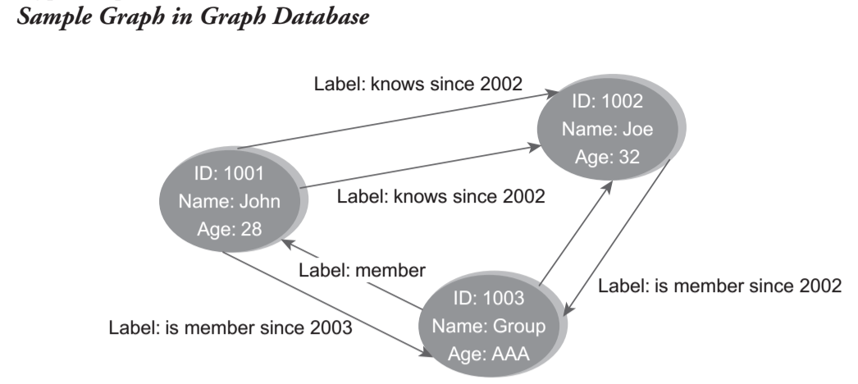

Slide 114
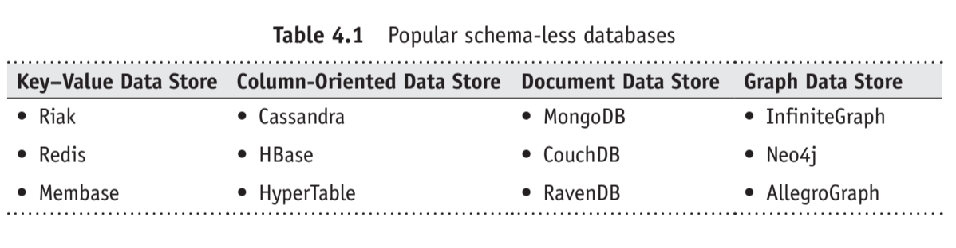
popular schema-less databases. .

Slide 115
Why NoSQL?
1. It has scale out architecture instead of the monolithic architecture of relational databases.
2. It can house large volumes of structured, semi-structured, and unstructured data.

Slide 116
3. Dynamic schema:
NoSQL database allows insertion of data without a pre-defined schema.
In other words, it facilitates application changes in real time, which thus supports faster development, easy code integration, and requires less database administration.

Slide 117
4. Auto-sharding:
It automatically spreads data across an arbitrary number of servers.
The application in question is more often not even aware of the composition of the server pool.
It balances the load of data and query on the available servers;
and if and when a server goes down, it is quickly replaced without any major activity disruptions.

Slide 118
5. Replication:
It offers good support for replication which in turn guarantees high availability, fault tolerance, and disaster recovery.

Slide 119
Advantages of NoSQL
1. Can easily scale up and down:
NoSQL database supports scaling rapidly and elastically and even allows to scale to the cloud.

Slide 120
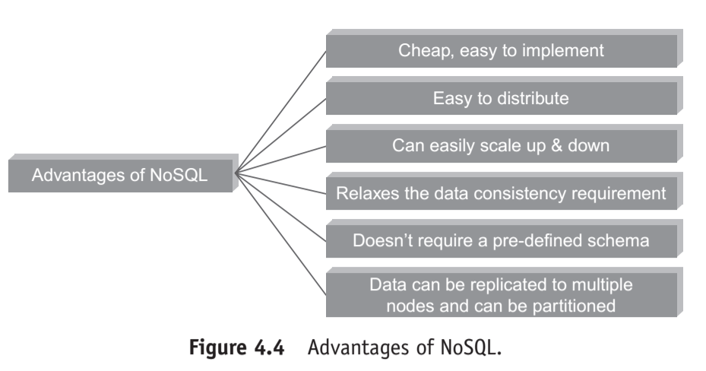

Slide 121
(a) Cluster scale: It allows distribution of database across 100+ nodes often in multiple data centers.
(b) Performance scale: It sustains over 100,000+ database reads and writes per second.
(c) Data scale: It supports housing of 1 billion+ documents in the database.

Slide 122
2. Doesn’t require a pre-defined schema:
NoSQL does not require any adherence to pre-defined schema.
It is pretty flexible.
For example, if we look at MongoDB,
the documents (equivalent of records in RDBMS) in a collection (equivalent of table in RDBMS) can have different sets of key-value pairs.

Slide 123
{_id: 101,“BookName”: “Fundamentals of business analytics”, “AuthorName”: “Seema Acharya”, “Publisher”: “Wiley India”}
{_id:102, “BookName”:”Big Data and Analytics”}

Slide 124
3. Cheap, easy to implement:
Deploying NoSQL properly allows for all of the benefits of scale, high availability, fault tolerance, etc. while also lowering operational costs.

Slide 125
4. Relaxes the data consistency requirement:
NoSQL databases have adherence to CAP theorem (Consistency, Availability, and PartitionTolerance).
Most of the NoSQL databases compromise on consistency in favor of availability and partition tolerance.
However, they do go for eventual consistency.

Slide 126
5. Data can be replicated to multiple nodes and can be partitioned: There are two terms that we will discuss

Slide 127
: (a) Sharding:
Sharding is when different pieces of data are distributed across multiple servers. NoSQL databases support auto-sharding meaning they can natively and automatically spread data across an arbitrary number of servers, without requiring the application to even be aware of the composition of the server pool.

Slide 128
Servers can be added or removed from the data layer without application downtime. This would mean that data and query load are automatically balanced across servers, and when a server goes down, it can be quickly and transparently replaced with no application disruption.

Slide 129
here (b) Replication: Replication is when multiple copies of data are stored across the cluster and even across data centers. This promises high availability and fault tolerance.

Slide 130
What We Miss With NoSQL?
With NoSQL around, we have been able to counter the problem of scale (NoSQL scales out).
There is also the flexibility with respect to schema design.
However there are few features of conventional RDBMS that are greatly missed.

Slide 131
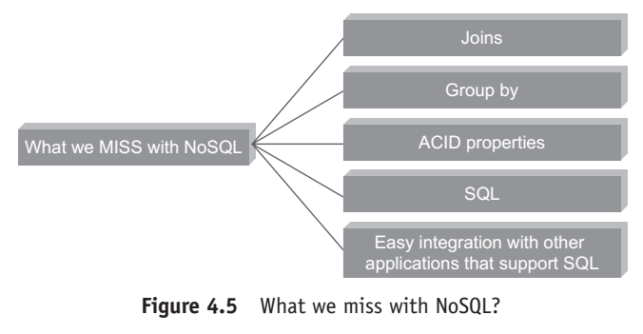

Slide 132
NoSQL does not support joins. However, it compensates for it by allowing embedded documents as in MongoDB. It does not have provision for ACID properties of transactions.
However, it obeys the Eric Brewer’s CAP theorem.

Slide 133
NoSQL does not have a standard SQL interface but NoSQL databases such as MongoDB and Cassandra have their own rich query language [MongoDB query language and Cassandra query language (CQL)] to compensate for the lack of it.

Slide 134
One thing which is dearly missed is the easy integration with other applications that support SQL.

Slide 135
Use of NoSQL in Industry
NoSQL is being put to use in varied industries.
They are used to support analysis for applications such as
web user data analysis,
log analysis,
sensor feed analysis,
making recommendations for up sell and cross-sell, etc. Refer Figure 4.6.

Slide 136
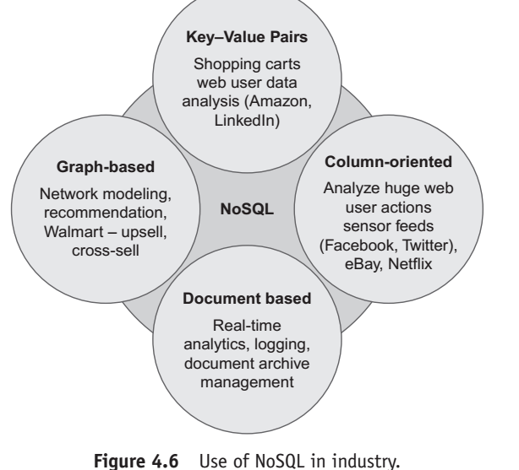

Slide 137
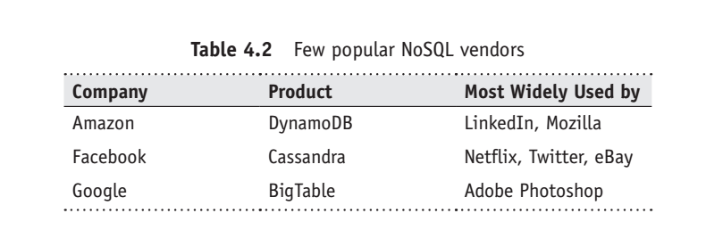
NoSQL Vendors

Slide 138
SQL versus NoSQL
Sr. | SQL | NoSQL
1 | Relational database | Non relational Distributed Database
2 | Relational Model | Model less approach
3 | Predefined schema | Dynamic Schema for unstructured data
4 | Table Based databases | Document based or graph based, wide column store or key value pair databases
5 | Vertically scalable (by increasing system resources) | Horizontally scalable (by creating cluster of commodity machines)
6 | Uses SQL | Uses UnQL (Unstructured Query Language)
7. | Not preferred for large datasets | Largely preferred for large datasets
8 | Not a best fit for hierarchical data | Best fit for hierarchical storage as it follows key value pairs of storing data similar to JSON (Java script object notation)

Slide 139
Sr. | SQL | NoSQL
9 | Emphasis on ACID properties | Follows brewers CAP Theorem
10 | Excellent support from vendors | Relied heavily on community support
11 | Supports complex querying and data keeping needs | Does not have good support for complex querying
12 | Can be configured for strong Consistency | Few support strong consistency (eg. Mongo DB), few others can be configured for eventual consistency. (eg. cassandra)
13 | Examples: Oracle, DB2,MySQL,MS SQL , Postgre SQL etc | Mongo DB, Hbase,cassandra,Redis,Neo4j, Couch DB,couchbase, Riak etc.

Slide 140
New SQL
We need a database that has the same scalable performance of NoSQL systems for On Line Transaction Processing (OLTP) while still maintaining the ACID guarantees of a traditional database.
This new modern RDBMS is called NewSQL.
It supports relational data model and uses SQL as their primary interface.

Slide 141
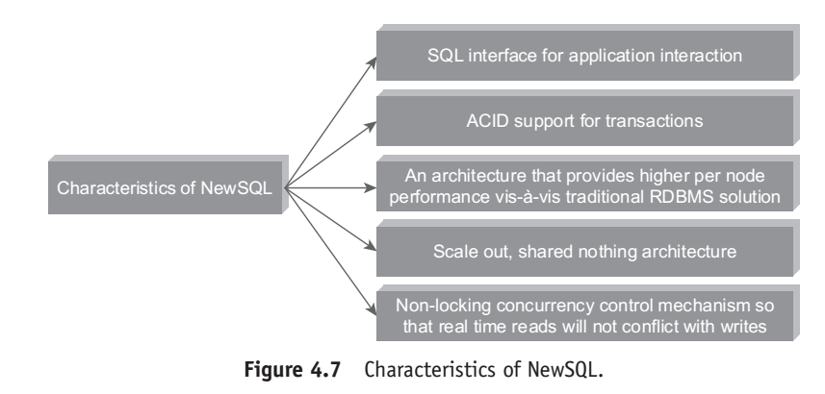
Characteristics of NewSQL

Slide 142
 | SQL | No SQL | New SQL
Adherence to ACID properties . | Yes | No | Yes
OLTP/OLAP | Yes | No | Yes
Schema rigidity | Yes | No | May be
Adherence to data model | Adherence to relational model
 | SQL | No SQL | New SQL
Adherence to ACID properties . | Yes | No | Yes
OLTP/OLAP | Yes | No | Yes
Schema rigidity | Yes | No | May be
Adherence to data model | Adherence to relational model

Slide 143
 | SQL | NoSQL | NEW SQL
Data Format Flexibility | No | Yes | May be
Scalability | Scale up Vertical Scaling | Scale out Horizontal Scaling | Scale out
Distributed Computing | Yes | Yes | Yes
Community Support | Huge | Growing | Slowly Growing

Slide 144
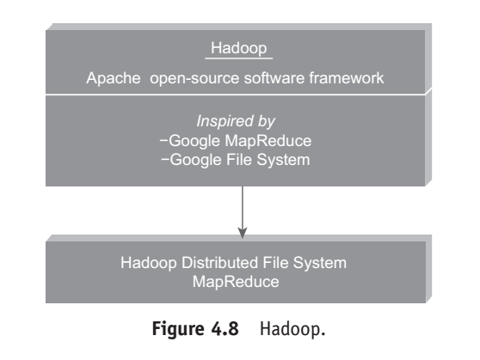

Slide 145
Hadoop
Hadoop is an open-source project of the Apache foundation.
It is a framework written in Java, originally developed by Doug Cutting in 2005 who named it after his son’s toy elephant.

Slide 146
He was working with Yahoo then.
It was created to support distribution for “Nutch”, the text search engine.
Hadoop uses Google’s MapReduce and Google File System technologies as its foundation.

Slide 147
Hadoop is now a core part of the computing infrastructure for companies such as Yahoo, Facebook, LinkedIn and Twitter.

Slide 148
Features of Hadoop
1. It is optimized to handle massive quantities of structured, semi-structured, and unstructured data, using commodity hardware, that is, relatively inexpensive computers.
2. Hadoop has a shared nothing architecture.

Slide 149
3. It replicates its data across multiple computers so that if one goes down, the data can still be processed from another machine that stores its replica.

Slide 150
4. Hadoop is for high throughput rather than low latency.
It is a batch operation handling massive quantities of data; therefore the response time is not immediate

Slide 151
5. It complements On-LineTransaction Processing (OLTP) and On-Line Analytical Processing (OLAP).
However, it is not a replacement for a relational database management system.

Slide 152
6. It is NOT good when work cannot be parallelized or when there are dependencies within the data.
7. It is NOT good for processing small files.
It works best with huge data files and data sets.

Slide 153
Key Advantages of Hadoop

Slide 154
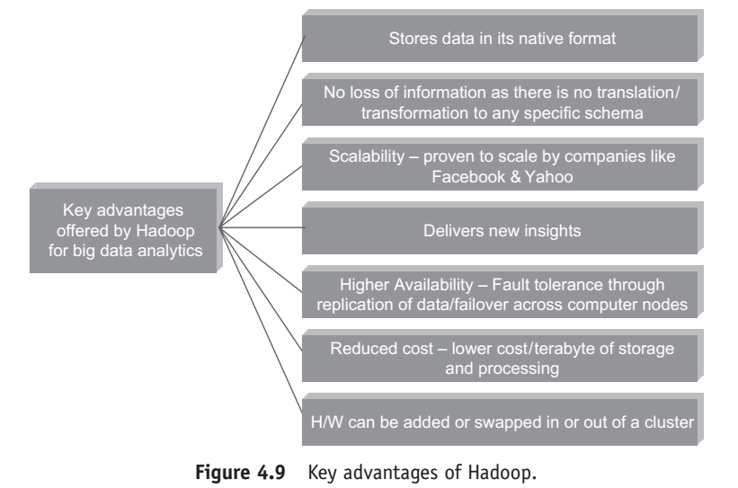

Slide 155
1. Stores data in its native format:
Hadoop’s data storage framework (HDFS – Hadoop Distributed File System) can store data in its native format.
There is no structure that is imposed while keying in data or storing data.

Slide 156
HDFS is pretty much schema-less.
It is only later when the data needs to be processed that structure is imposed on the raw data.

Slide 157
2. Scalable:
Hadoop can store and distribute very large datasets (involving thousands of terabytes of data) across hundreds of inexpensive servers that operate in parallel.

Slide 158
3. Cost-effective:
Owing to its scale-out architecture, Hadoop has a much reduced cost/terabyte of storage and processing.

Slide 159
4. Resilient to failure:
Hadoop is fault-tolerant.
It practices replication of data diligently which means whenever data is sent to any node, the same data also gets replicated to other nodes in the cluster, thereby ensuring that in the event of a node
failure, there will always be another
copy of data available for use.

Slide 160
5. Flexibility:
One of the key advantages of Hadoop is its ability to work with all kinds of data: structured, semi-structured, and unstructured data.
It can help derive meaningful business insights from email conversations, social media data, click-stream data, etc.
It can be put to several purposes such as log analysis, data mining, recommendation systems, market campaign analysis, etc.

Slide 161
6. Fast:
the processing is extremely fast in Hadoop compared to other conventional systems owing to the “move code to data” paradigm.

Slide 162
Versions of Hadoop
There are two versions of Hadoop available:
1. Hadoop 1.0
2. Hadoop 2.0

Slide 163
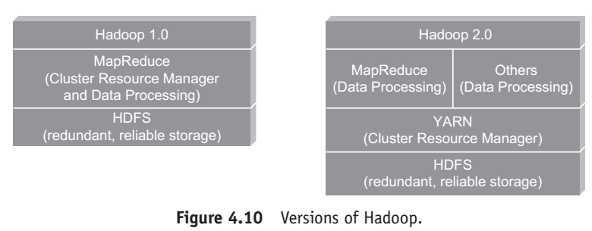

Slide 164
Hadoop 1.0
It has two main parts:
1. Data storage framework:
It is a general-purpose file system called Hadoop Distributed File System (HDFS).
HDFS is schema-less. It simply stores data files and these data files can be in just about any format.

Slide 165
The idea is to store files as close to their original form as possible. .
This is turn provides the business units and the organization the much needed flexibility and agility without being overly worried by what it can implement.

Slide 166
2. Data processing framework:
This is a simple functional programming model initially popularized by Google as MapReduce. It essentially uses two functions: the MAP and the REDUCE functions to process data.

Slide 167
The “Mappers” take in a set of key-value pairs and generate intermediate data (which is another list of key-value pairs).
The “Reducers” then act on this input to produce the output data.

Slide 168
The two functions seemingly work in isolation from one another, thus enabling the processing to be highly distributed in a highly-parallel, fault-tolerant, and scalable way.

Slide 169
limitations of Hadoop 1.0.
1. The first limitation was therequirement for MapReduce programming expertise along with proficiency required in other programming languages, notably Java

Slide 170
2. It supported only batch processing which although is suitable for tasks such as log analysis, large-scale data mining projects but pretty much unsuitable for other kinds of projects.

Slide 171
3. One major limitation was that Hadoop 1.0 was tightly computationally coupled with MapReduce, which meant that the established data management vendors were left with two options: Either rewrite their functionality in MapReduce so that it could be executed in Hadoop or extract the data from HDFS and process it outside of Hadoop

Slide 172
None of the options were viable as it led to process inefficiencies caused by the data being moved in and out of the Hadoop cluster.

Slide 173
Hadoop 2.0
In Hadoop 2.0, HDFS continues to be the data storage framework.
However, a new and separate resource management framework called Yet Another Resource Negotiator (YARN) has been added.

Slide 174
Any application capable of dividing itself into parallel tasks is supported by YARN. YARN coordinates the allocation of subtasks of the submitted application, thereby further enhancing the flexibility, scalability, and efficiency of the applications.

Slide 175
It works by having an ApplicationMaster in place of the erstwhile JobTracker, running applications on resources governed by a new NodeManager (in place of the erstwhile TaskTracker).
ApplicationMaster is able to run any application and not just MapReduce.

Slide 176
Overview of Hadoop Ecosystems
Components of the Hadoop ecosystem
1. HDFS:
Hadoop Distributed File System. It simply stores data files as close to the original form as possible.

Slide 177
2. HBase:
It is Hadoop’s database and compares well with an RDBMS. It supports structured data storage for large tables

Slide 178
. 3. Hive:
It enables analysis of large data sets using a language very similar to standard ANSI SQL.
This implies that anyone familiar with SQL should be able to access data stored on a Hadoop cluster.

Slide 179
4. Pig:
Pig is an easy to understand data flow language.
It helps with the analysis of large datasets which is quite the order with Hadoop.

Slide 180
Even if one does not have the proficiency in MapReduce programming, the analysts and the persons entrusted with the task of comprehending data will still be able to analyze the data in a Hadoop cluster as the Pig scripts are automatically converted into MapReduce jobs by the Pig interpreter.

Slide 181
5. ZooKeeper:
It is a coordination service for distributed applications.
6. Oozie:
It is a workflow scheduler system to manage Apache Hadoop jobs

Slide 182
7. Mahout: It is a scalable machine learning and data mining library. 8. Chukwa: It is a data collection system for managing large distributed systems

Slide 183
9. Sqoop:
It is used to transfer bulk data between Hadoop and structured data stores such as relational databases.
10. Ambari:
It is a web-based tool for provisioning, managing, and monitoring Apache Hadoop clusters.

Slide 184
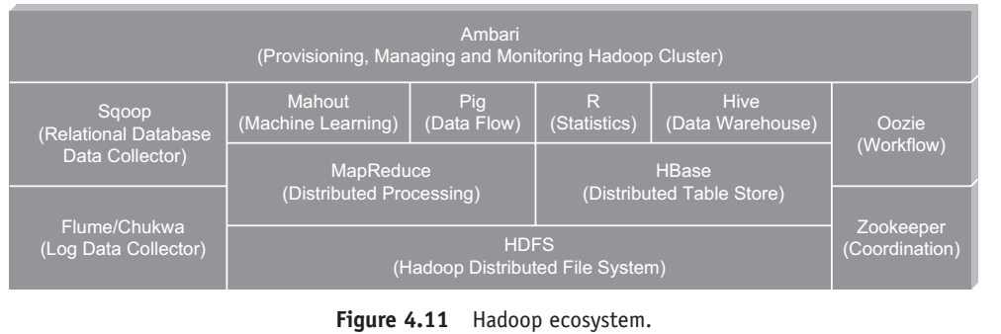

Slide 185
Hadoop Distributions
Hadoop is an open-source Apache project.
Anyone can freely download the core aspects of Hadoop.

Slide 186
The core aspects of Hadoop
1. Hadoop Common
2. Hadoop Distributed File System (HDFS)
3. Hadoop YARN (Yet Another Resource Negotiator)
4. Hadoop MapReduce

Slide 187
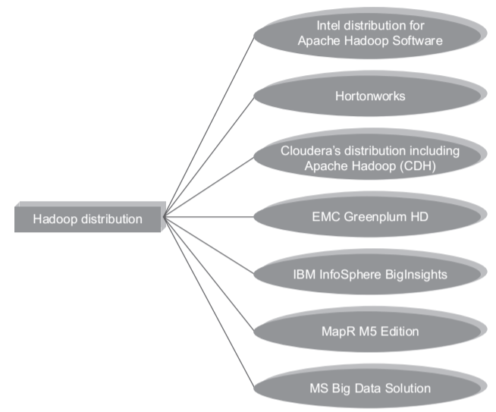

Slide 188
Hadoop versus SQL
Hadoop | SQL
Scale Out | Scale UP
Key value Pairs | Relational tables
Functional Programming | Declarative Queries
Offline Batch Processing | On-line transaction processing

Slide 189
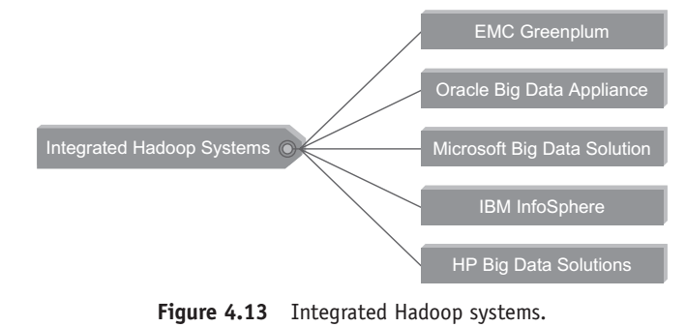
Integrated Hadoop Systems Offered by Leading Market Vendors

Slide 190
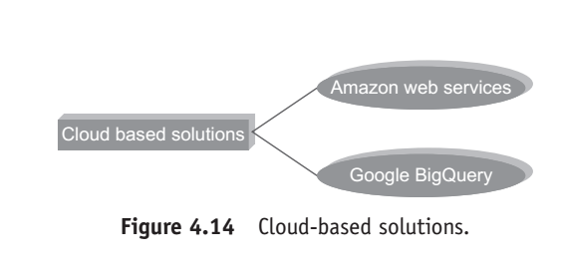
Cloud-Based Hadoop Solutions

Slide 191
Amazon Web Services holds out a comprehensive, end-to-end portfolio of cloud computing services to help manage big data.
The aim is to achieve this and more along with retaining the emphasis on reducing costs, scaling to meet demand, and accelerating the speed of innovation.

Slide 192
The Google Cloud Storage connector for Hadoop empowers one to perform MapReduce jobs directly on data in Google Cloud Storage, without the need to copy it to local disk and running it in the Hadoop Distributed File System (HDFS).

Slide 193
The connector simplifies Hadoop deployment, and at the same time reduces cost and provides performance comparable to HDFS, all this while increasing reliability by eliminating the single point of failure of the name node.

Slide 194
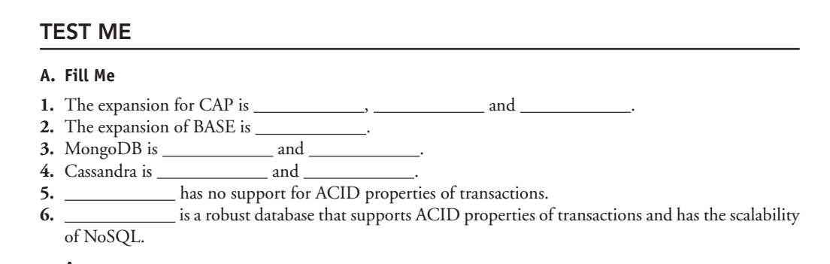

Slide 195
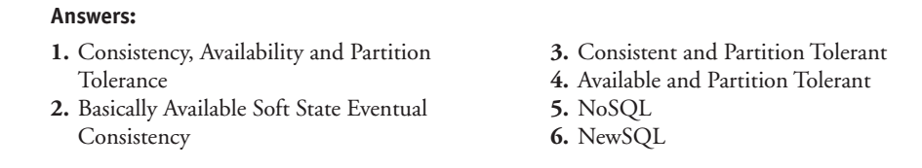

Slide 196
Place me in Basket
SQL | NoSQL

Slide 197
Following words are to be placed in the relevant basket: (a) Relational
(b) Distributed
(c) Predefined schema
(d) Wide-column stores
(e) Vertically scalable
(f) Key−value pairs

Slide 198
(g) MySQL
(h) CouchDB
(i) Neo4j
(j) Cassandra
(k) Large dataset
(l) ACID properties

Slide 199
(m) Brewers CAP theorem
(n) Document based database
(o) Scales horizontally
(p) Avoids join operations
(q) JSON data
(r) Table or relations

Slide 200
